Slide 1
Projects to Manage
Jake Andersen

Slide 2
A Model in efficiency
Time over Gain

Slide 3
The Objective
Accomplish the task within the time constraints in the most efficient manner in regards to allocation of resources.
Experiment for Average progress over time Experiment other progress affecting factors Determine best use of time Build a model for project completion using the least amount of time, over the allotted period of time.

Slide 4
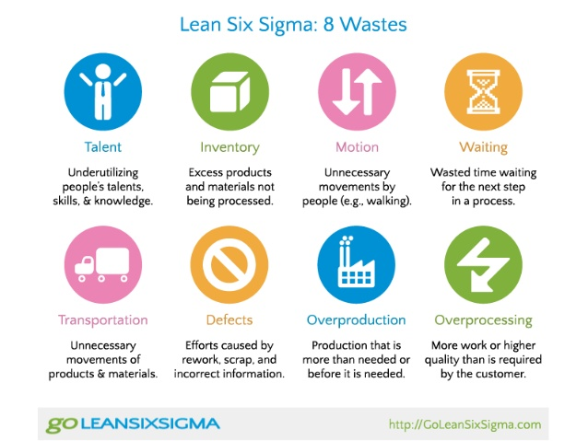
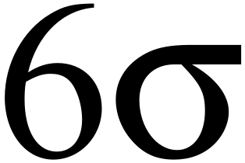
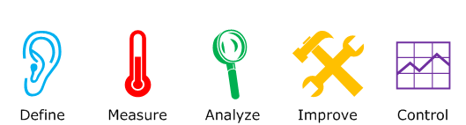
The Principles

Slide 5
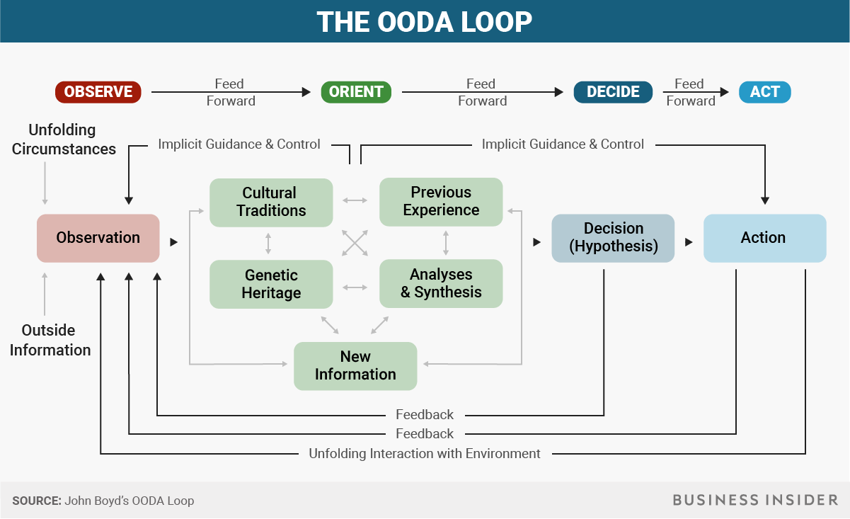

Slide 6
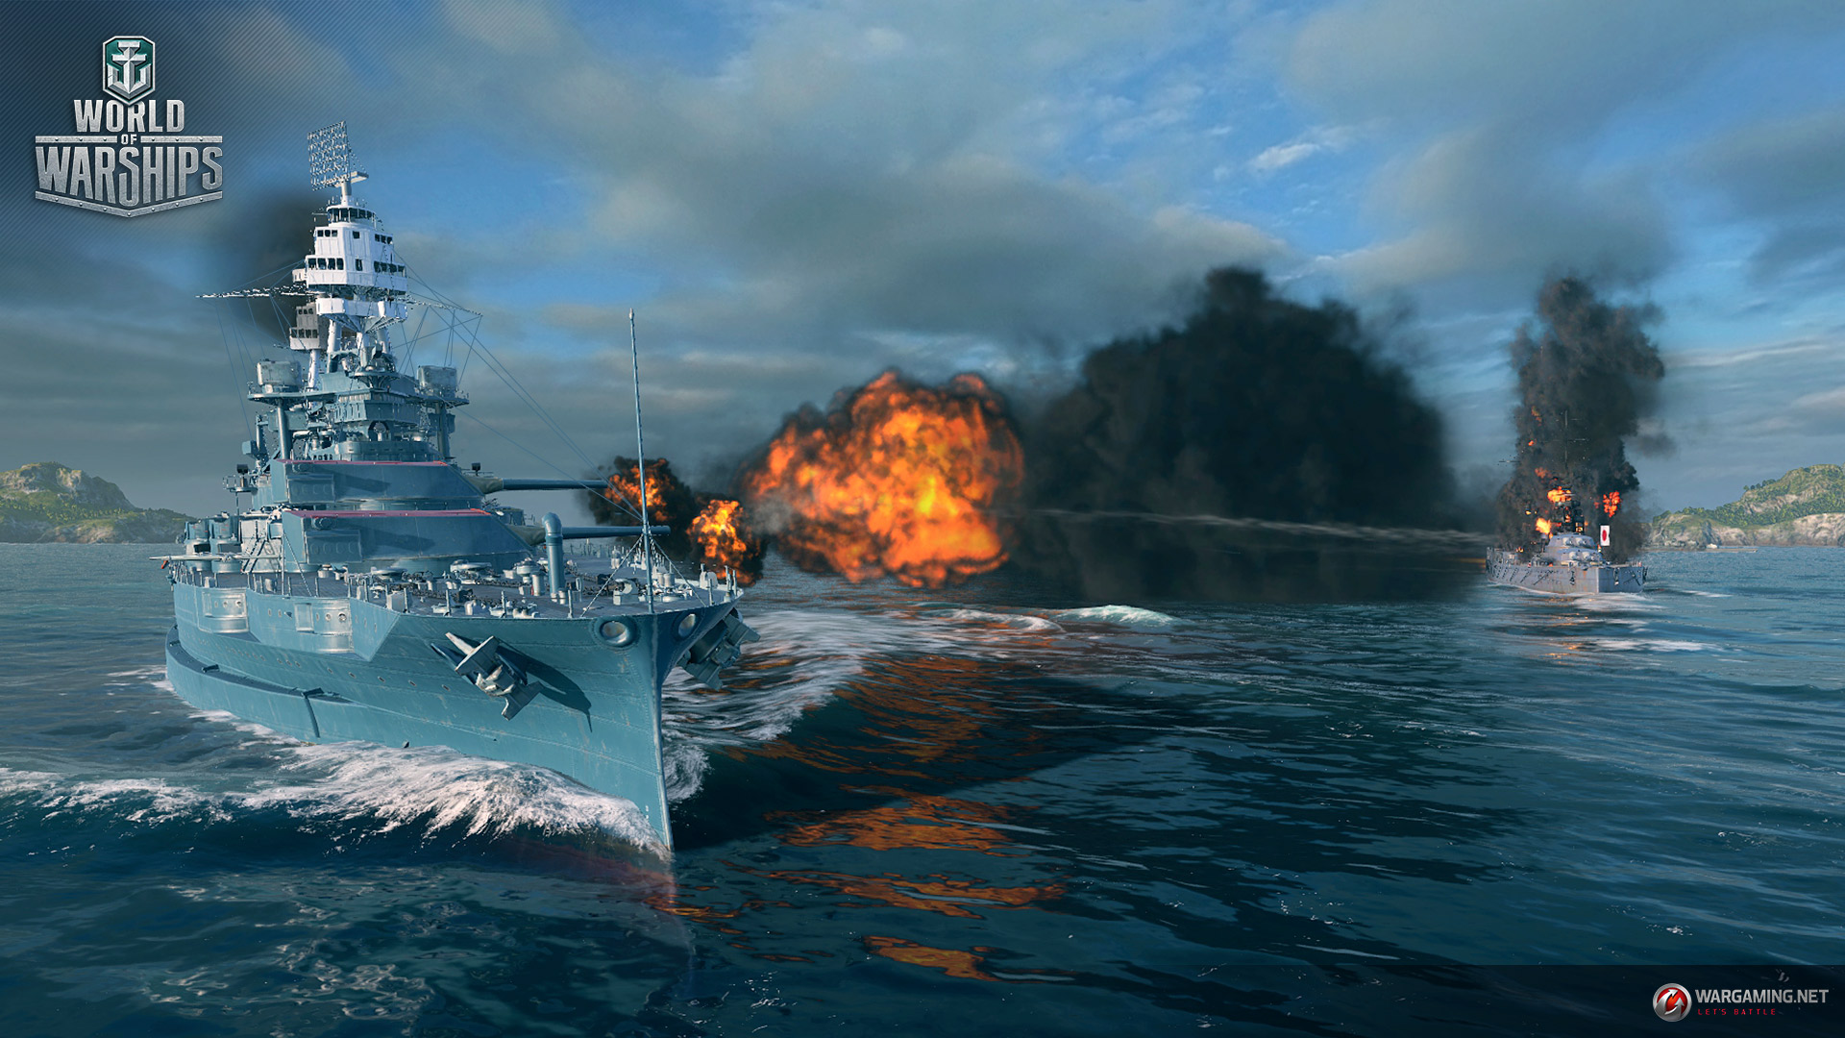


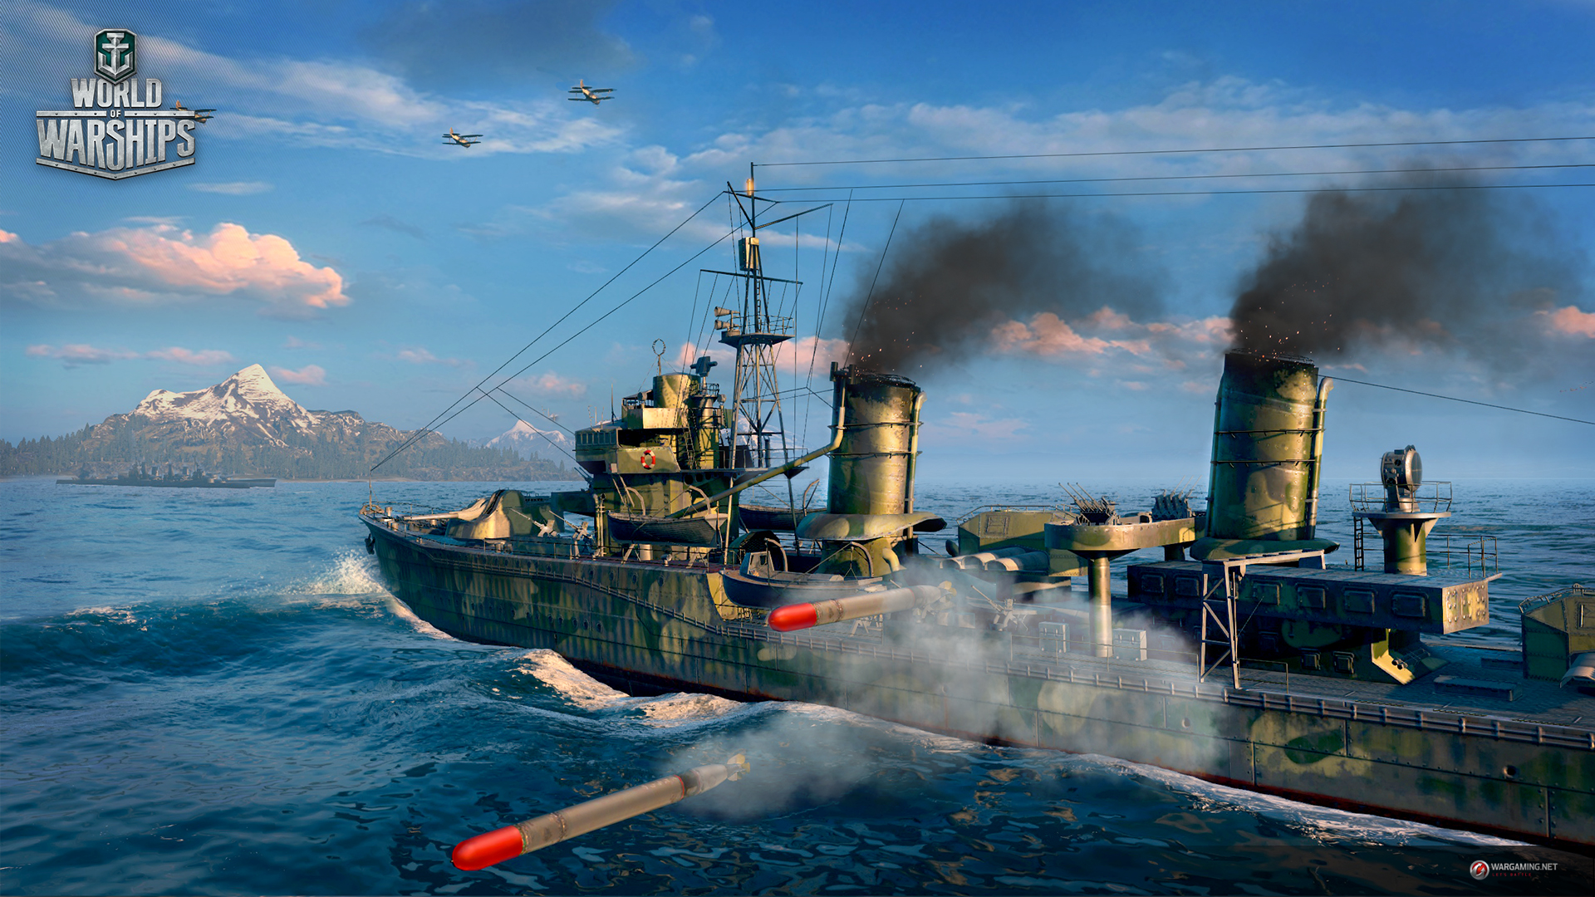
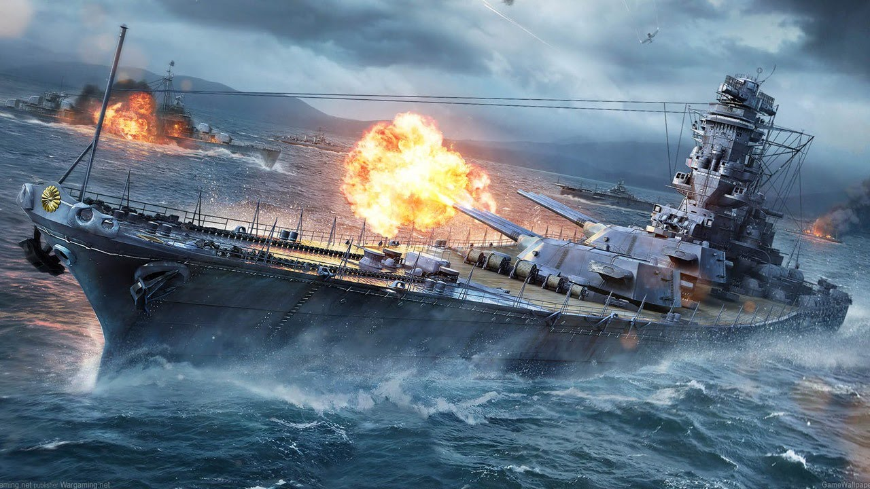

Slide 7
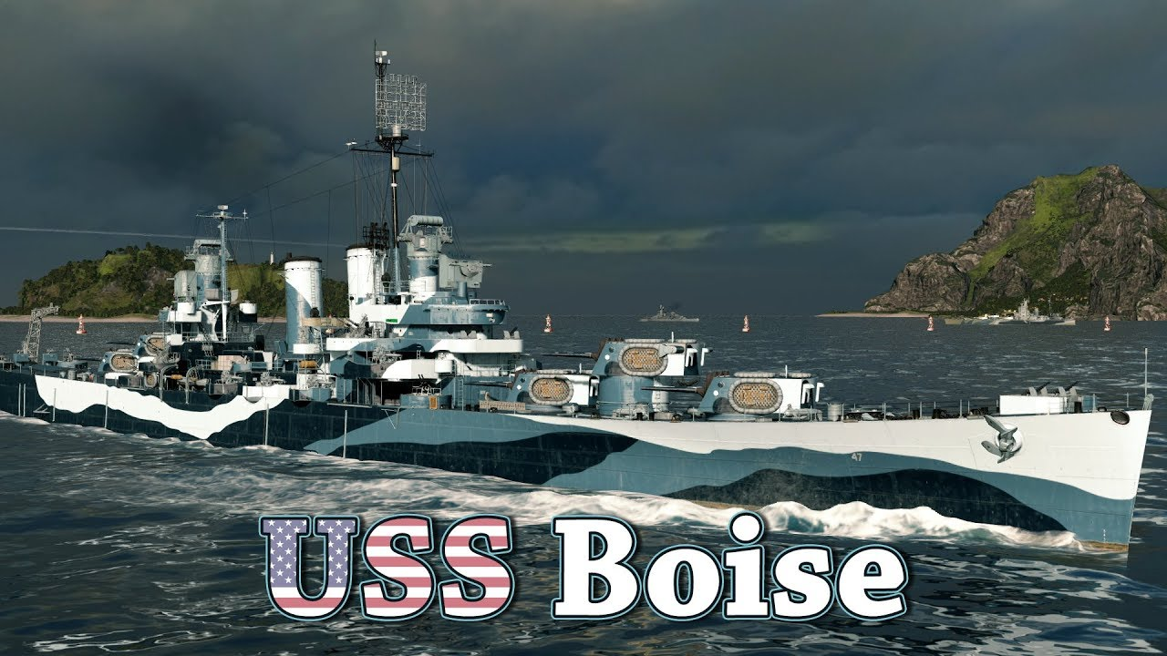
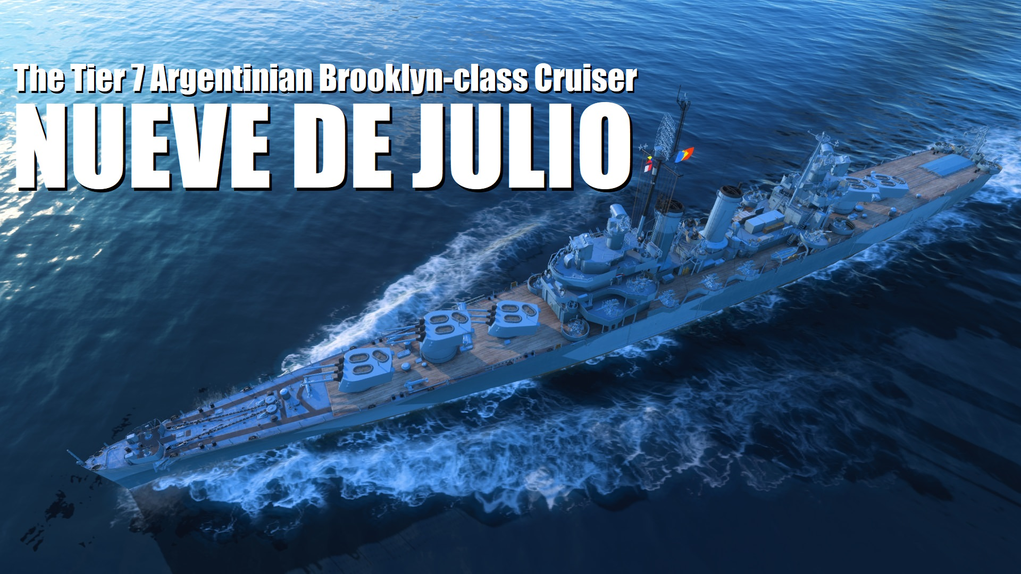
Project: Earn the Nuevo de Julio
Earn 300,000xp on the USS Boise Must be done before 12/31/18

Slide 8
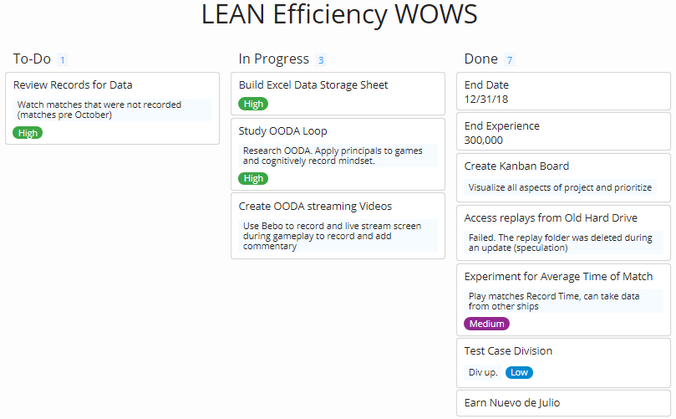
The Board

Slide 9

The Data
 | Time of Match | Xp Earned | XP per minute | First Victory? | Premium? | Division? | Victory?
1 | 0:15:01 | 4,804.00 | 319.91 | y | n | n | y
2 | 0:11:18 | 5,950.00 | 526.55 | y | n | n | y
3 | 0:12:44 | 4,036.00 | 316.96 | n | n | n | y
4 | 0:12:41 | 2,778.00 | 219.03 | n | n | n | n
5 | 0:12:25 | 4,334.00 | 349.05 | y | n | n | y
6 | 0:11:59 | 5,062.00 | 422.42 | n | n | y | y
7 | 0:11:01 | 2,909.00 | 264.05 | n | n | y | y
8 | 0:12:54 | 5,723.00 | 443.64 | n | n | y | y
9 | 0:14:26 | 3,804.00 | 263.56 | n | n | y | n
10 | 0:15:46 | 9,593.00 | 608.44 | y | n | n | y
11 | 0:18:28 | 2,837.00 | 153.63 | n | n | n | n
12 | 0:13:30 | 2,523.00 | 186.89 | n | n | n | n
13 | 0:16:39 | 5,224.00 | 313.75 | y | n | y | y
14 | 0:09:52 | 5,109.00 | 517.80 | y | n | y | y
15 | 0:17:08 | 11,973.00 | 698.81 | n | n | y | y
16 | 0:13:13 | 5,530.00 | 418.41 | n | n | y | y
17 | 0:12:46 | 4,806.00 | 376.45 | n | n | y | y
18 | 0:17:06 | 6,841.00 | 400.06 | n | n | y | y
19 | 0:11:07 | 7,232.00 | 650.55 | n | n | y | y
20 | 0:19:04 | 4,027.00 | 211.21 | n | n | y | n
21 | 0:11:17 | 4,975.00 | 440.92 | n | n | y | y
22 | 0:12:13 | 1,939.00 | 158.72 | n | n | n | n
Length of the time the ship was in battle (unusable)
XP earned per match
XP earned per minute of match
Potential Modifiers

Slide 10
The Results
Games played in a division yielded noticeably better results than without.
First Victory +50% bonus did not make a significant difference.
Life expectancy has a direct result on experience earned. IE when you’re dead, you cannot earn more XP.
 | Avg XP | Avg XP/Min
Defeat | 2,984.67 | 198.84
Defeat/Div | 3,915.50 | 237.38
Victory | 5,881.31 | 441.74
Division | 5,944.00 | 449.72
First+Div | 5,166.50 | 415.78
First Victory | 5,835.67 | 439.25

Slide 11
The Conclusions
Playing one game a day (to maximize bonus XP earned) would be disadvantageous as first matches (including first wins) failed to over perform battles after I had warmed up.
Grinding it out in a few days would be disadvantageous as prolonged playing would enact the law of diminishing returns (Bonuses would wear out, skill would stagnate, increased rate of loss as duration continued).
Divisions with friends always helped us perform better, thereby increasing our returns. The most efficient use of time was playing with Friends for as long as we could, no more than 10 matches.

Slide 12
A Model in Production
Startup and Break-Even point Versus Time and Effort

Slide 13
The Objective
Review three different methods to yield a product.
Evaluate initial investment required, time per production, and size of operation.
Compare break-even points and time required.
Choose method that best fits your needs and business model.

Slide 14
The Production Plans
Linear/Waterfall/Batch
Perform a single step on an entire batch of product, then perform the next step on an entire batch and so on until that batch is finished.
Spiral/Cyclical/Iterative
Perform every step on a single product, then repeat the entire process on another product, then another until the batch is finished.
Chain/Multipath/Assembly
Perform a single step on a single product. Perform the second step on the first product and the first step on the second product. Perform the third step on the first product, second on the second, and first on the third. Repeat until batch is finished.

Slide 15
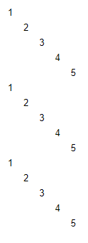
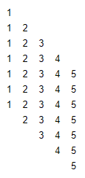
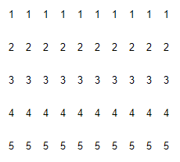
The Production Plans

Slide 16
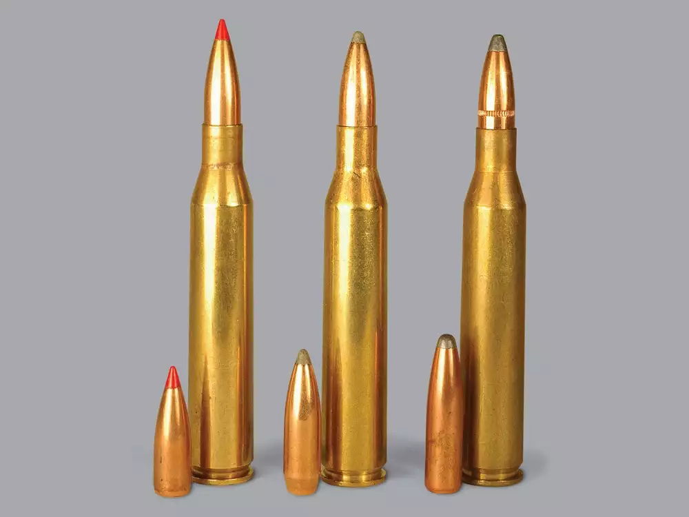
The Project: Acquire 25-06 Ammunition
Find the most financially responsible way to use a 25-06 Rifle.
Store Bought Ammo? Hand Reloaded Ammo? Other?

Slide 17
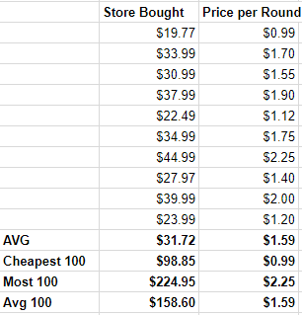
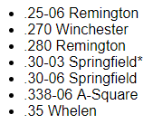
The Store-Bought Ammos
25-06 is among the more expensive of ammunitions. Despite being a member of a great cartridge family, it is considered a specialty round (Wildcat) and is harder to come by most other rounds.

Slide 18
The Reloading Process
https://i.pinimg.com/564x/51/4e/68/514e6894e98172aeacc034aa7a4defd3.jpg
Reloading is widely considered the best way to get accurate rounds in the least expensive way. Let’s review what reloading entails.

Slide 19
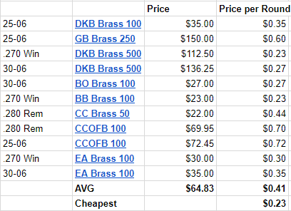
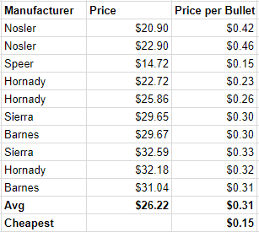
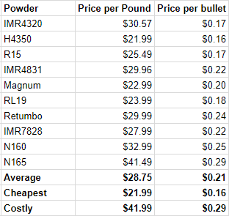
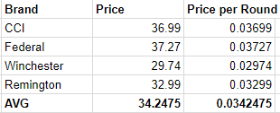
The Costs
Once-Fired Brass
Bullets
Powder
Primers

Slide 20
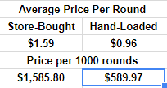
The Comparison
Brass can be used multiple times, at least 5, sometimes as much as 12 times before it becomes damaged and unusable. This projecture assumed we could get 10 uses out of the fired brass.

Slide 21
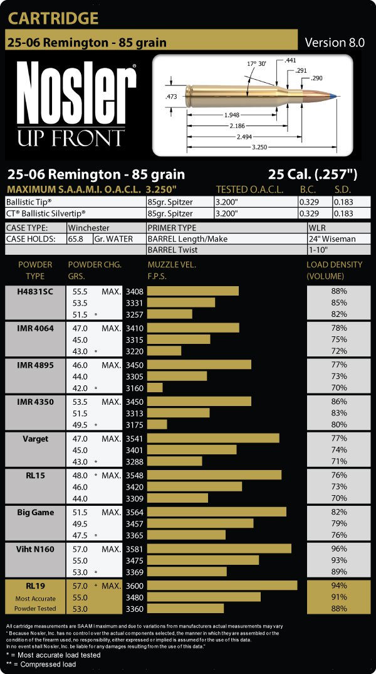
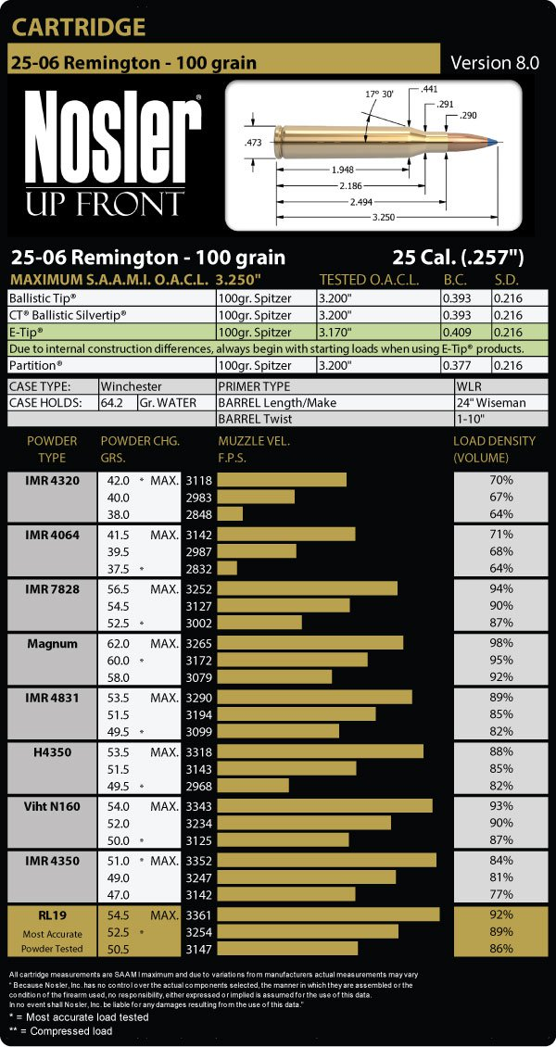
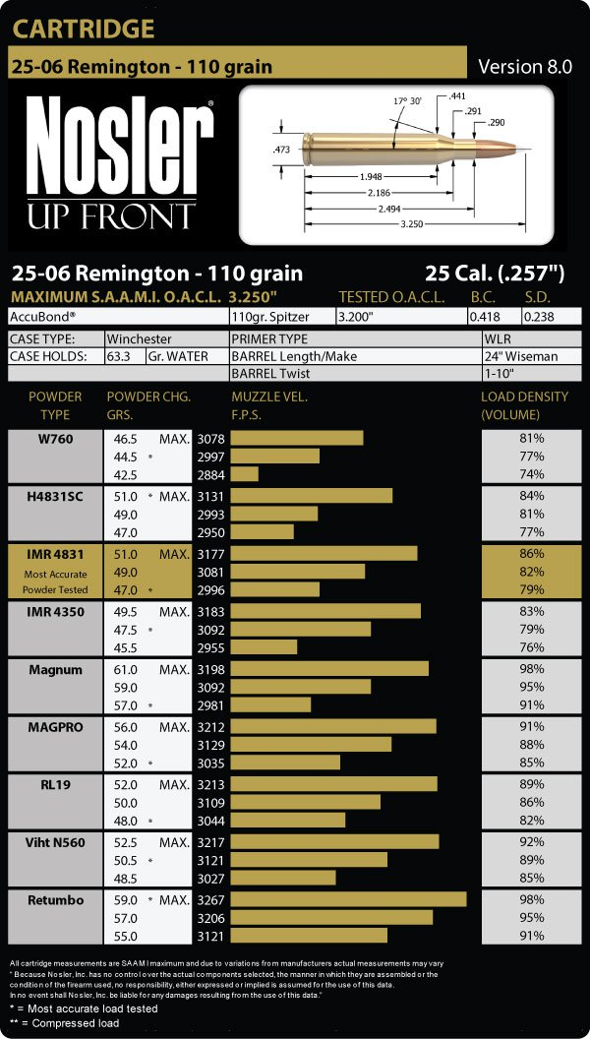
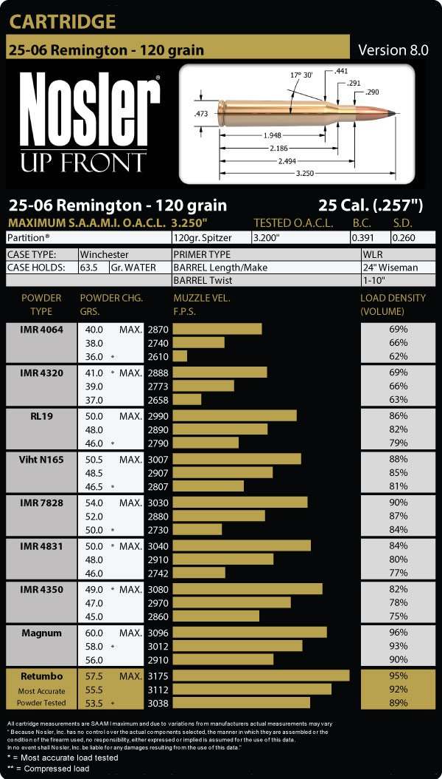
Some Loading Charts for Reference

Slide 22
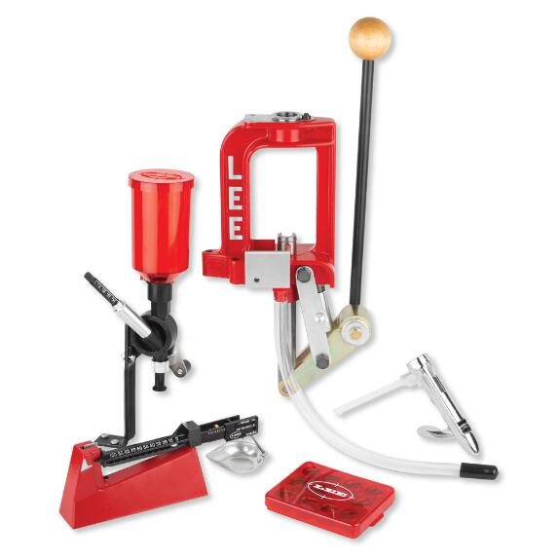
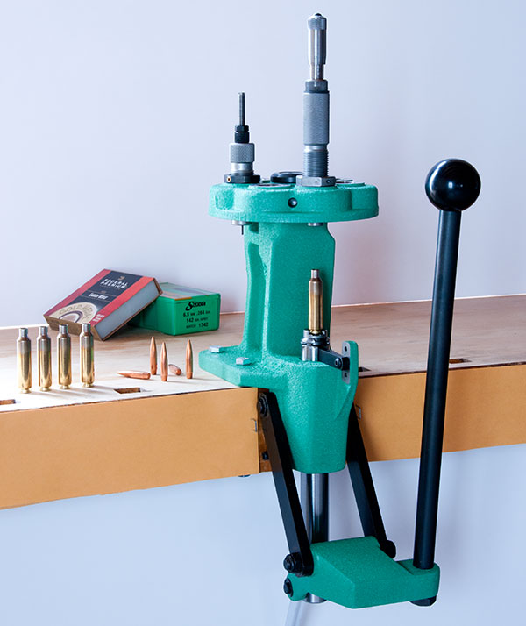
The Single-Stage Reloading Process
Least initial investment
Highest time investment
A number of equipment layout options
Requires hands on every step
$40-$400

Slide 23
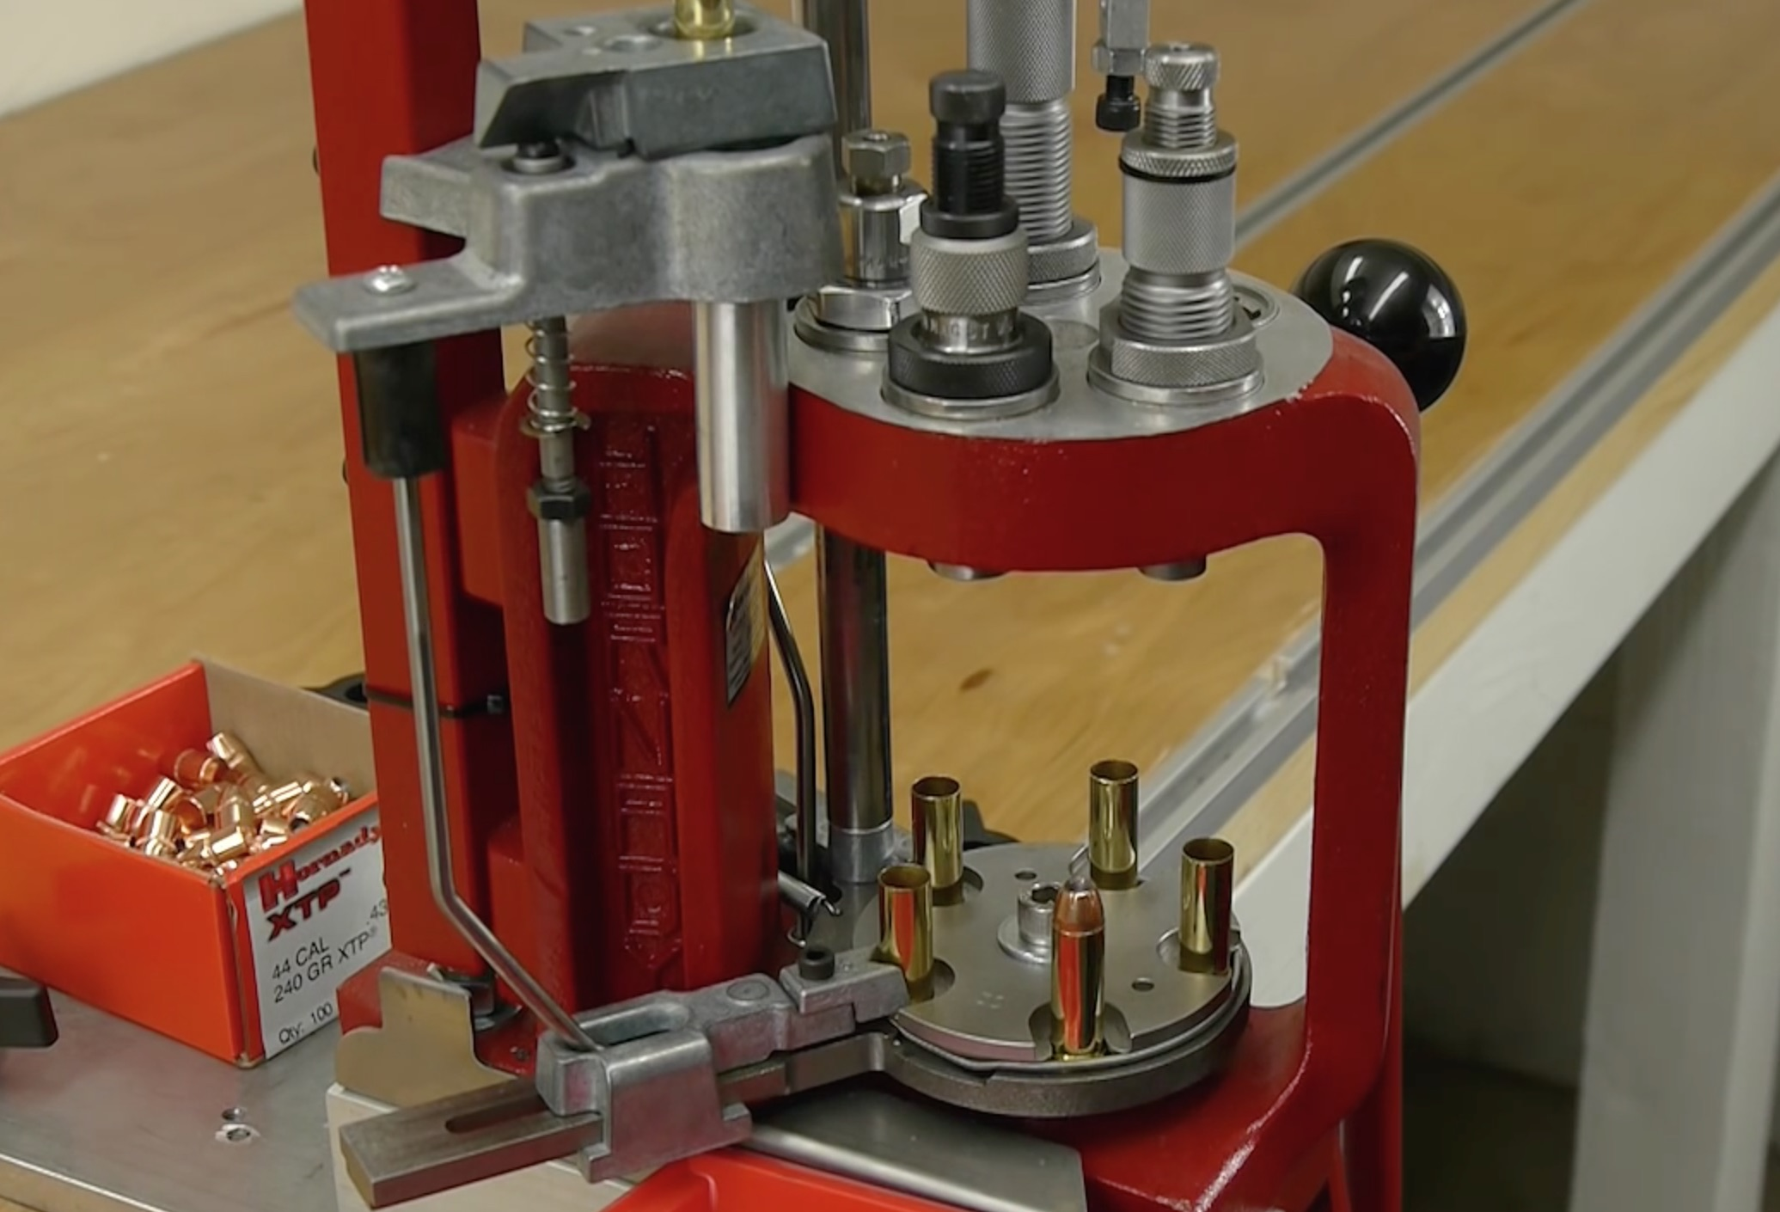
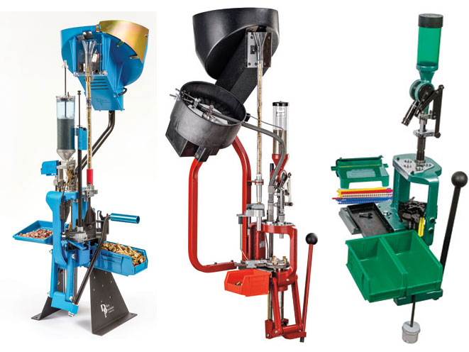
The Progressive Reloading Process
Highest initial investment
Least time investment
Almost completely automated process
Every pull of the lever produces a new round
Minimal user interaction
$260-$1250

Slide 24
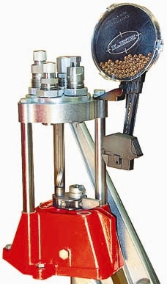
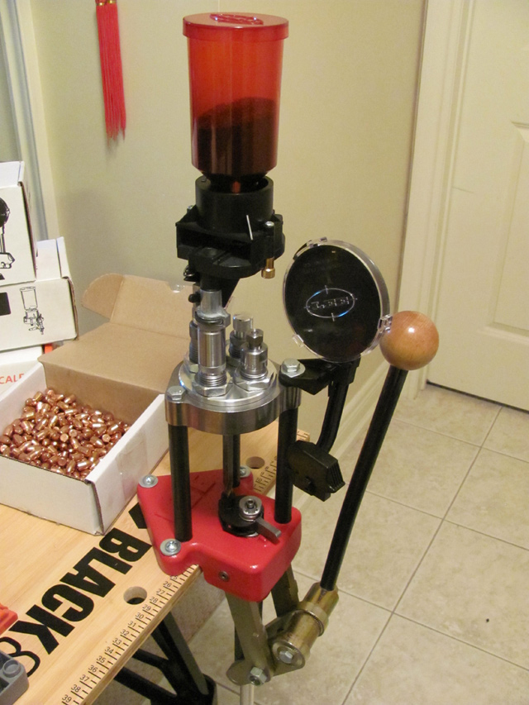
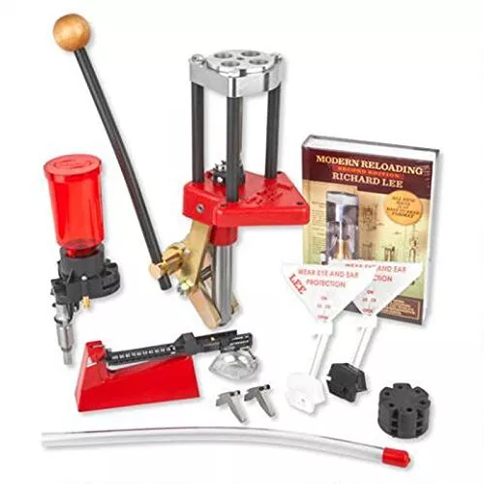
The Hybrid Process (Turret Press)
Medium Initial Investment
Medium Time Investment
Takes one round from start to finish in four level pulls
Requires some user interaction
$134-$265

Slide 25
The Comparison (part 2)
Single Stage:
$140 for Press, Powder Measure and brass handling tools.
2-3 hours for a batch of 100 rifle rounds so about 40 per hour.
Hybrid:
$240 for Press and add-ons.
150-200 rounds per hour on average.
Progressive:
$600 for Press and basic add-ons.
200-300 rounds per hour on average.

Slide 26
The Results
Single Stage:
$590+140+40=$770
1000/40=25
It takes $770 and 25 hours to make 1000 rounds
Break-Even point versus Store bought Ammo: 484 (12.1 hours)
Hybrid:
$590+240+40=$870
1000/150=6.67
It takes $870 and 5-7 hours to make 1000 rounds
Break-Even point versus Store bought Ammo: 547 (2.7-3.6 hours)
Progressive:
$590+600+40=$1230
It takes $1230 and 3-5 hours to make 1000 rounds
Break-Even point versus Store bought Ammo: 774 (2.7-3.8 hours)

Slide 27
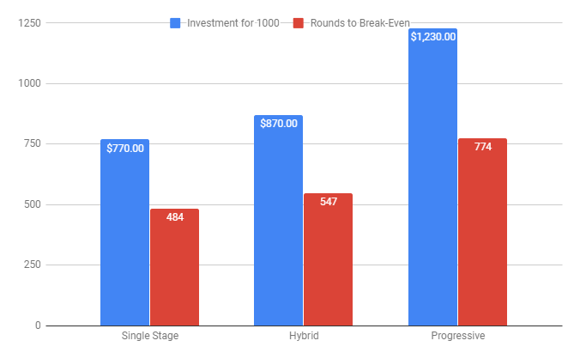
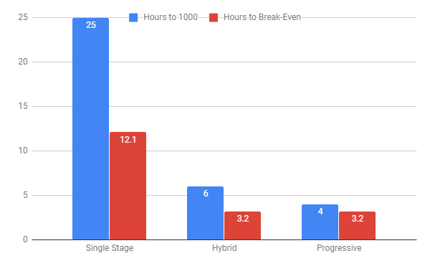
The Results (cont)

Slide 28
The Conclusion
As a casual hobbyist with limited time AND capital, I decided to go with the Hybrid option as it had a small startup cost and was only slightly less productive than the progressive reloader in hour-long increments, which would be all the time I can invest at a time. Also, with using smarter purchasing decisions, I even got my price per round down to $0.50.
400 brass = $30 (pawn shop, 30-06) 100 Sierra Bullets = $23 (on sale, 110 gr) H4350 = $21.99 (retail) Winchester Primers = $29.99
0.075+0.23+0.16+0.02999=0.49499 $0.49-50 per round

Slide 29
The Principles Reviewed

Slide 30
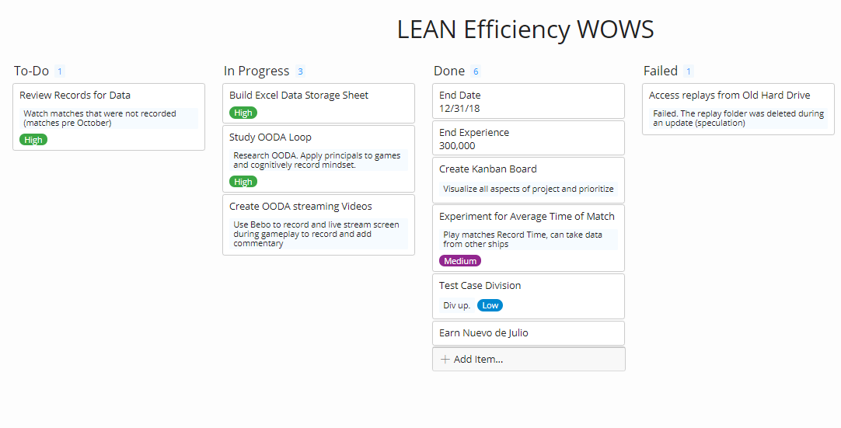
Kanban

Slide 31
Kanban
Kanban helps to minimize potential human errors by opening up communication and accountability. With effective organizational practices, bottlenecks can be minimized, planned for, or avoided altogether. Seamless transitions between tasks help manage time and reduce waste. With a clear goal and defined steps, the process doesn’t need to rehashed at the start of everyday, rather, it is reviewed.

Slide 32
Six Sigma/LEAN

Slide 33
Six Sigma/LEAN
Define, Measure, Analyze, Improve, Control I defined the Project (Earn the Ship), Measured the criteria and necessary milestones, Analyzed the collected data, improved the expenditure of time, Controlled the outcome.
By identifying areas of waste (divisionless playing, waiting for ship after I sink, certain strategies in game that would limit my abilities or expend my resources), I could improve my returns and streamline quality of the process.

Slide 34
OODA Loop
OODA Loop

Slide 35
OODA Loop
By continually observing the movements and engagements of the enemy and my own team, and orienting my decisions based upon what I know and have learned about certain ship types, their playstyles, and team patterns, I can act based on those objective decisions to defeat my opponents.

Slide 36
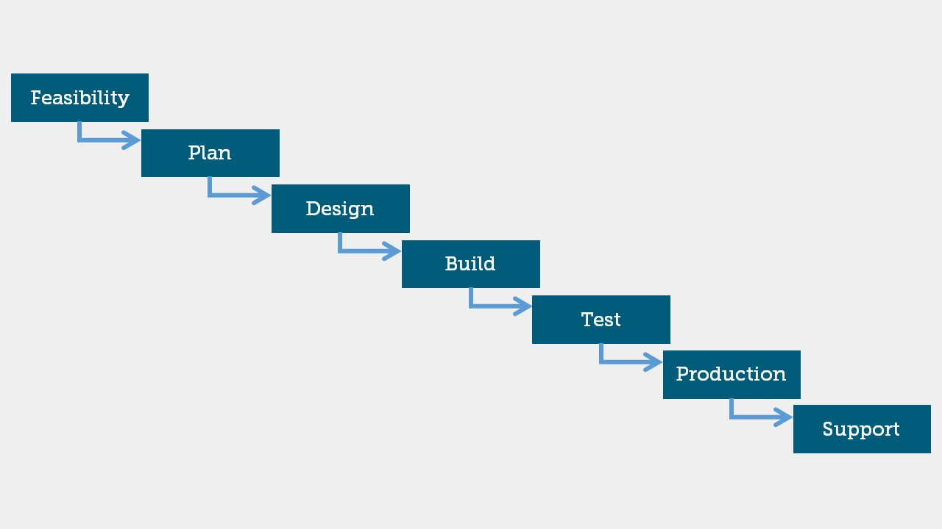
Waterfall

Slide 37
Waterfall
With Single-Stage reloading, one must really grasp the Waterfall method. You determine your objective, plan the process, design the apparati, build the rounds (step by step), test the batch, make adjusts as needed, then rinse repeat. No step can be completed without the previous steps being done and the current step must be finished for all products before moving on and changing the equipment you are using.

Slide 38
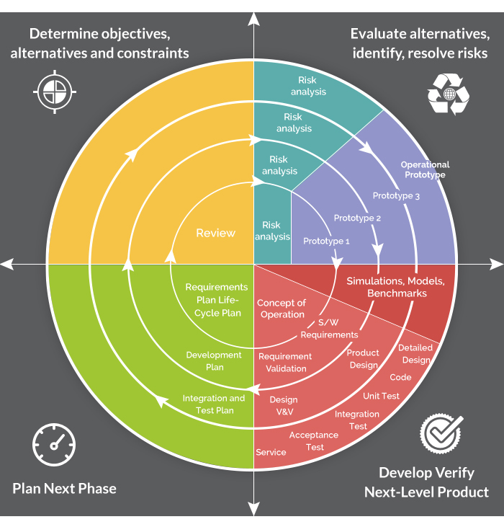
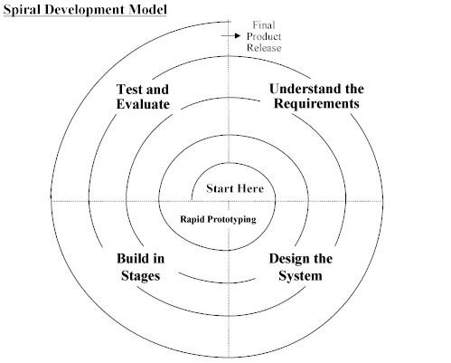
Spiral Model

Slide 39
Spiral Model
The Hybrid reloading process is very much a Spiral Model in two ways. First the obvious cyclical nature of producing the rounds: Performing every step on one product until it is completed, then move on to the next one. In the world of reloading, this opens up a Spiral Model’s true potential to perfect the product through quick evaluations and iterations. By producing a single complete product every process, one can test the favorability of each product and improve immediately without any loss of resources to subpar or defective products from a bad batch. Preventing risk and danger is especially important when dealing with live ammunition and firearms.

Slide 40
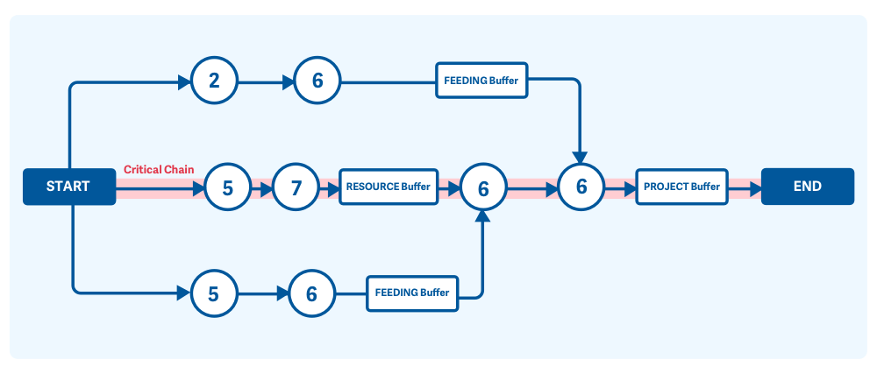
Critical Chain (Multiple Critical Path)

Slide 41
Critical Path/Critical Chain Management
With the Progressive Reloader, you are all about Time Management and efficiency. You want to plan appropriately, take your necessary measures before the start of your process in order to not meet any slow downs. By investing in brass hoppers and bullet feeding tubes, you can minimize and even eliminate the potential bottlenecks of human interaction and have a semi-automatic production line. If such investments cannot be made, having trays and bins handy will reduce the feeding buffers and resource buffers in the assembly line.

Slide 42
Fin

